Slide 1

CS 332 Artificial Intelligence
School of Computer Engineering AND TECHNOLOGY

Slide 2

CS 332 Artificial Intelligence
Teaching Scheme Credits: 2 + 1 = 3
Theory: 4 Hrs / Week Practical: 2 Hrs / Week
Course Objectives:
To understand the concept of Artificial Intelligence (AI)
To learn various peculiar search strategies for AI
To develop a mind to solve real world problems unconventionally with optimality
Course Outcomes:
Identify and apply suitable Intelligent agents for various AI applications
Design smart system using different informed search / uninformed search or heuristic approaches.
Identify knowledge associated and represent it by ontological engineering to plan a strategy to solve given problem.

Slide 3
Syllabus
Knowledge Representation and Planning
Propositional logic and predicate logic, Knowledge Representation structure such as frame, Conceptual dependencies, Semantic networks and script, Resolution in predicate logic, Unification algorithm, Forward and Backward chaining, Logic Programming
Planning: Forward and Backward planning, Goal Stack Planning, Hierarchical Planning.

Slide 4
Knowledge Representation and Planning

Slide 5
Contents
Propositional logic and predicate logic
Knowledge Representation structure such as frame, Conceptual dependencies, Semantic networks and script
Resolution in predicate logic
Unification algorithm
Forward and Backward chaining
Logic Programming
Forward and Backward planning
Goal Stack Planning and Hierarchical Planning

Slide 6

Knowledge bases
Knowledge Representation
– Facts: Things we want to represent. Truth in some
relevant world.
– Representation of facts.
Notes:
t inference engines were components of expert systems. The typical expert system consisted of a knowledge base and an inference engine. The knowledge base stored facts about the world. The inference engine applied logical rules to the knowledge base and deduced new knowledge. This process would iterate as each new fact in the knowledge base could trigger additional rules in the inference engine. Inference engines work primarily in one of two modes either special rule or facts: forward chaining and backward chaining. Forward chaining starts with the known facts and asserts new facts. Backward chaining starts with goals, and works backward to determine what facts must be asserted so that the goals can be achieved.^{[1]}
A simple example of Modus Ponens often used in introductory logic books is "If you are human then you are mortal". This can be represented in pseudocode as:
Rule1: Human(x) => Mortal(x)

Slide 7
A knowledge-based agent
A knowledge-based agent includes a knowledge base and an inference system.
A knowledge base is a set of representations of facts of the world.
Each individual representation is called a sentence.
The sentences are expressed in a knowledge representation language.
The agent operates as follows:
1. It TELLs the knowledge base what it perceives.
2. It ASKs the knowledge base what action it should perform.
3. It performs the chosen action.

Slide 8
The Wumpus World environment
The agent explores a cave consisting of rooms connected by passageways.
Lurking somewhere in the cave is the Wumpus, a beast that eats any agent that enters its room.
Some rooms contain bottomless pits that trap any agent that wanders into the room.
The Wumpus can fall into a pit too, so avoids them Occasionally, there is a heap of gold in a room.
The goal is to collect the gold and exit the world without being eaten

Slide 9
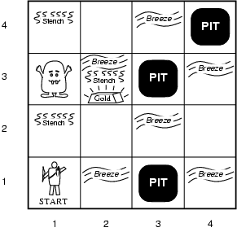
Wumpus World PEAS description
Performance measure
gold +1000, death -1000
-1 per step, -10 for using the arrow
Environment
Squares adjacent to wumpus are smelly Squares adjacent to pit are breezy Glitter if gold is in the same square Shooting kills wumpus if you are facing it Shooting uses up the only arrow Grabbing picks up gold if in same square Releasing drops the gold in same square
Sensors: Stench, Breeze, Glitter, Bump, Scream Actuators: Left turn, Right turn, Forward, Grab, Release, Shoot

Slide 10
Logic
Drawing reasonable conclusions from a set of data (observations, beliefs, etc) seems key to intelligence
Logic is a powerful and well developed approach to this and highly regarded by people
Logic is also a strong formal system that we can program computers to use
Maybe we can reduce any AI problem to figuring out how to represent it in logic and apply standard proof techniques to generate solutions.
Intelligent agents should have capacity for:
• Perceiving, that is, acquiring information from environment,
• Knowledge Representation, that is, representing its understanding of the world,
• Reasoning, that is, inferring the implications of what it knows and of the choices it has, and
• Acting, that is, choosing what it want to do and carry it out

Slide 11
Continued…
Knowledge can also be represented by the symbols of logic, which is the study of the rules
of exact reasoning.
■ Logic is also of primary importance in expert systems in which the inference engine reasons
from facts to conclusions.
■ A descriptive term for logic programming and expert systems is automated reasoning systems.

Slide 12
Logic in general
Logics are formal languages for representing information such that conclusions can be drawn
Syntax defines the sentences in the language
Semantics define the "meaning" of sentences
i.e., define truth of a sentence in a world
E.g., the language of arithmetic
x+2 ≥ y is a sentence; x2+y > {} is not a sentence
x+2 ≥ y is true iff the number x+2 is no less than the number y
x+2 ≥ y is true in a world where x = 7, y = 1
x+2 ≥ y is false in a world where x = 0, y = 6

Slide 13
Representation, reasoning, and logic
The object of knowledge representation is to express knowledge in a computer-tractable form, so that agents can perform well.
A knowledge representation language is defined by its syntax, which defines all possible sequences of symbols that constitute sentences of the language.
Ex: Sentences in a book, bit patterns in computer memory its semantics, which determines the facts in the world to which the sentences refer.
Each sentence makes a claim about the world.
An agent is said to believe a sentence about the world.

Slide 14
Types of Logic
There are a number of logical systems with different syntax and semantics.
Propositional logic
Predicate logic

Slide 15
Propositional Logic
Propositional logic is a symbolic logic for manipulating propositions
Propositional logic is concerned with declarative sentences that can be classified as either true or false
A sentence whose truth value can be determined is called a statement or proposition
A statement is also called a closed sentence because its truth value is not open to question
Statements that cannot be answered absolutely are called open sentences
A compound statement is formed by using logical connectives on
individual statements

Slide 16
Propositional logic
The symbols of propositional calculus are the propositional symbols:
P, Q, R, S, …
Truth symbols:
true, false
and connectives:
∧, ∨, ¬, →, ≡

Slide 17
Propositional logic
In propositional logic (PL) an user defines a set of propositional symbols, like P and Q. User defines the semantics of each of these symbols. For example,
P means "It is hot"
Q means "It is humid"
R means "It is raining"
Examples of PL sentences:
o (P ^ Q) => R (here meaning "If it is hot and humid, then it is raining")
o Q => P (here meaning "If it is humid, then it is hot")
o Q (here meaning "It is humid.")

Slide 18
Truth Table

Slide 19
Inference rules in Propositional logic
1. Idempotent rule:
P ˄ P ==> P
P ˅ P ==> P
2. Commutative rule:
P ˄ Q ==> Q ˄ P
P ˅ Q ==> Q ˅ P
3.Associative rule:
P ˄ (Q ˄ R) ==> (P ˄ Q) ˄ R
P ˅ (Q ˅ R) ==> (P ˅ Q) ˅ R

Slide 20
Continued…
4. Distributive Rule:
P ˅ (Q ˄ R) ==> (P ˅ Q) ˄ (P ˅ R)
P ˄ (Q ˅ R) ==> (P ˄ Q) ˅ (P ˄ R)
5. De-Morgan’s Rule:
ך(P ˅ Q) ==> ךP ˄ ךQ
ך (P ˄ Q) ==> ך P ˅ ךQ
6. Implication elimination:
P → Q => ךP ˅ Q

Slide 21
Continued…
7. Bidirectional Implication elimination:
( P ⬄ Q ) ==> ( P → Q ) ˄ (Q → P)
8. Contrapositive rule:
P → Q => ךP → ךQ
9. Double Negation rule:
ך )ך P) => P
10. Absorption Rule:
P ˅ ( P ˄ Q) => P
P ˄ ( P ˅ Q) => P

Slide 22
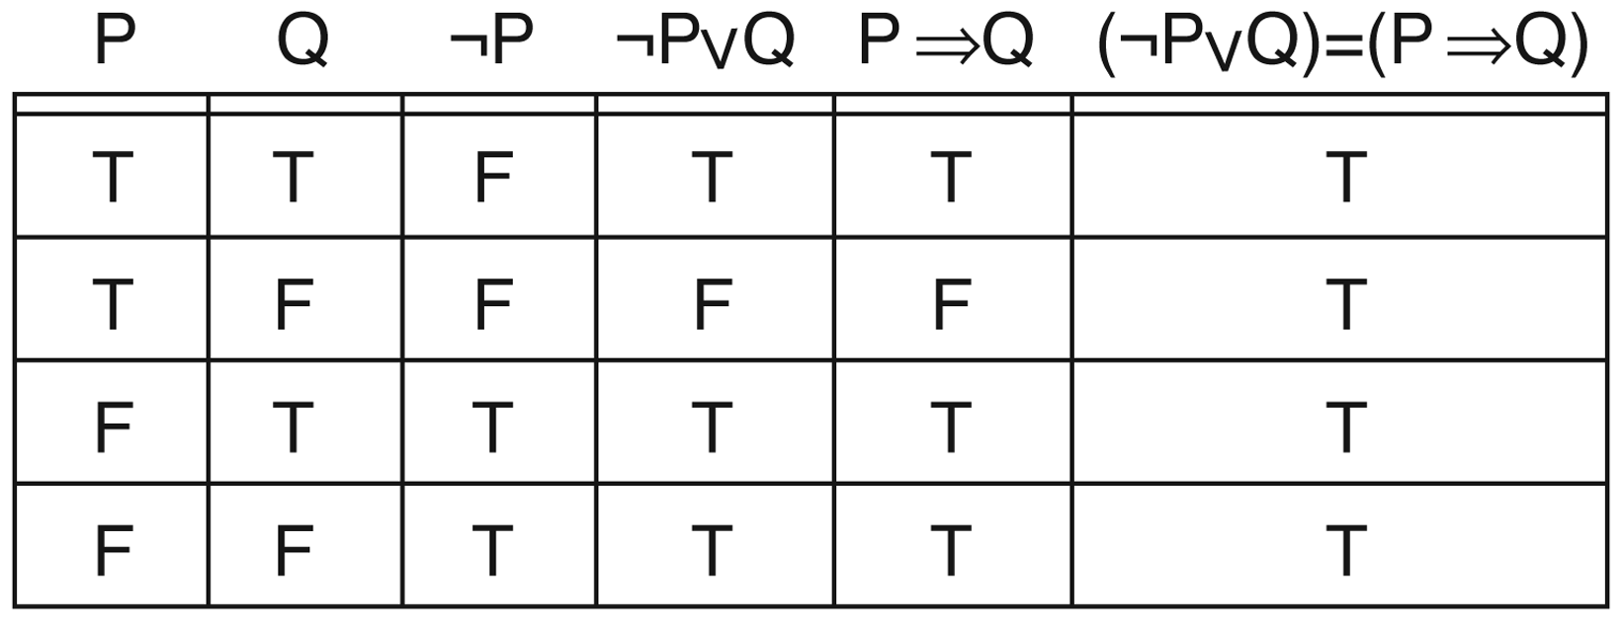
¬P∨Q and P→Q

Slide 23
Continued…
Example:
“I will get wet if it rains and I go out of the house”
Let Propositions be:
W : “I will get wet “
R : “it rains “
S : “I go out of the house”
(S ˄ R) → W

Slide 24
Pros and cons of propositional logic
Propositional logic is declarative
Propositional logic allows partial/disjunctive/negated information
Propositional logic is compositional
Propositional logic has very limited expressive power

Slide 25
Predicate Logic
Representing simple facts (Preposition)
“SOCRATES IS A MAN”
SOCRATESMAN ---------1
“PLATO IS A MAN”
PLATOMAN ---------2
Fails to capture relationship between Socrates and man. We do not get any information about the objects involved
Ex: if asked a question : “who is a man?” we cannot get
answer. Using Predicate Logic however we can represent above
facts as: Man(Socretes) and Man(Plato)
1. Marcus was a man. man(Marcus)

Slide 26
Continued…
Representation and Mapping
• Spot is a dog
dog(Spot)
• Every dog has a tail
Spot has a tail

Slide 27
Quantifiers
1. Universal quantifier (∀)
• ∀x: means “for all” x
• It is used to represent phrase “ for all”.
• It says that something is true for all possible values of
a variable.
• Ex. “ John loves everyone”
∀x: loves(John , x)

Slide 28
Continued…
2. Existential quantifier ( ∃ ):
• Used to represent the fact “ there exists some”
• Ex:
• “some people like reading and hence they gain good
knowledge”
∃ x: { [person(x) ∧ like (x , reading)] →gain(x, knowledge) }
• “lord Haggins has a crown on his head”
• ∃ x: crown(x) ∧ onhead (x , Haggins)

Slide 29
Continued…
3. Nested Quantifiers
• We can use both ∀ and ∃ seperately
• Ex: “ everybody loves somebody ”
∀x: ∃y: loves ( x , y)
• Connection between ∀ and ∃
• “ everyone dislikes garlic”
∀ x: ¬ like ( x , garlic )
➢ This can be also said as:
“there does not exists someone who likes garlic”
¬ ∃x: like (x, garlic)

Slide 30
Continued…
All Romans were either loyal to Caesar or hated him.
∀x: Roman(x) → loyalto (x, Caesar) ∨ hate(x, Caesar)
4. Every one is loyal to someone.
∀x: ∃y: loyalto(x, y) ∃y: ∀x: loyalto(x, y)
5. People only try to assassinate rulers they are not loyal to.
∀x: ∀y: person(x) ∧ ruler(y) ∧ tryassassinate(x, y)
→ ¬loyalto(x, y)

Slide 31
Inference Methods
Unification (prerequisite)
Forward Chaining
Backward Chaining
Logic Programming (Prolog)
Resolution
Transform to CNF (Chomsky normal form )
Generalization of Prop. Logic resolution
Notes:
In formal language theory, a context-free grammar G is said to be in Chomsky normal form (first described by Noam Chomsky)^{[1]} if all of its production rules are of the form:^{[2]:92–93,106}
A → BC, or A → a, or S → ε, where A, B, and C are nonterminal symbols, a is a terminal symbol (a symbol that represents a constant value), S is the start symbol, and ε denotes the empty string. Also, neither B nor C may be the start symbol, and the third production rule can only appear if ε is in L(G), namely, the language produced by the context-free grammar G.

Slide 32
Forward Chaining
Forward Chaining
Start with atomic sentences in the KB and apply Modus Ponens in the forward direction, adding new atomic sentences, until no further inferences can be made.
P implies Q and P is asserted to be true, so therefore Q must be true
Given a new fact, generate all consequences
Assumes all rules are of the form
Each rule & binding generates a new fact
This new fact will “trigger” other rules
Keep going until the desired fact is generated

Slide 33
Example Knowledge Base
The law says that it is a crime for an American to sell weapons to hostile nations. The country Nono, an enemy America, has some missiles, and all of its missiles were sold to it by Col. West, who is an American.
Prove that Col. West is a criminal.

Slide 34
Example Knowledge Base
It is a crime for an American to sell weapons to hostile nations
American(x) ∧Weapon(y) ∧Sells(x,y,z) ∧Hostile(z) ⇒ Criminal(x)
Nono…has some missiles
∃x Owns(Nono, x) ∧ Missiles(x)
Owns(Nono, M₁) and Missle(M₁)
All of its missiles were sold to it by Col. West
∀x Missle(x) ∧ Owns(Nono, x) ⇒ Sells( West, x, Nono)
Missiles are weapons
Missle(x) ⇒ Weapon(x)

Slide 35
Example Knowledge Base
An enemy of America counts as “hostile”
Enemy( x, America ) ⇒ Hostile(x)
Col. West who is an American
American( Col. West )
The country Nono, an enemy of America
Enemy(Nono, America)

Slide 36
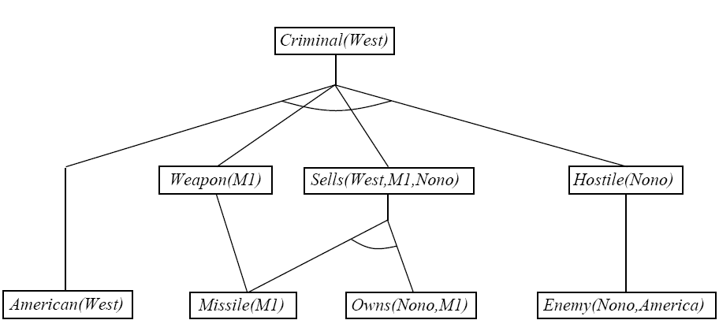
Example Knowledge Base

Slide 37
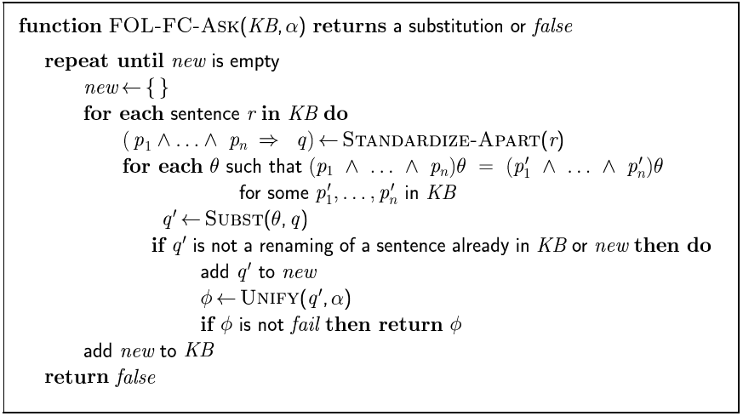
Forward Chaining Algorithm

Slide 38
Backward Chaining
Consider the item to be proven a goal
Find a rule whose head is the goal (and bindings)
Apply bindings to the body, and prove these (subgoals) in turn
If you prove all the subgoals, increasing the binding set as you go, you will prove the item.
Logic Programming (cprolog, on CS)

Slide 39
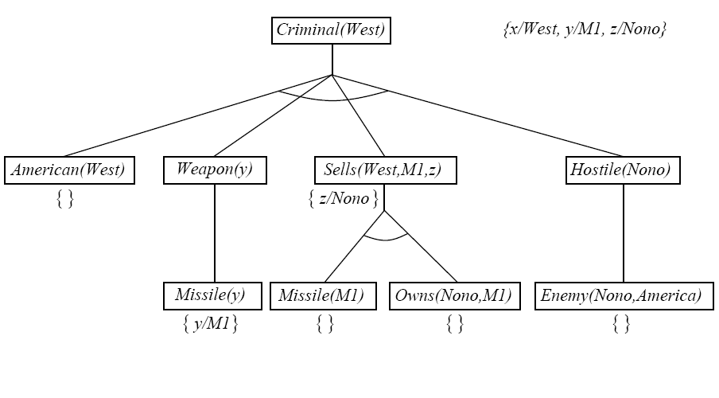
Backward Chaining Example

Slide 40
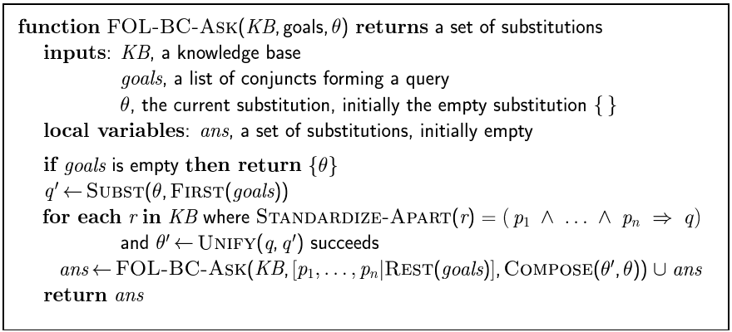
Backward Chaining Algorithm

Slide 41
Logic Programming
Logic Programming
Identify problem
Assemble information
Encode information in KB
Encode problem instance as facts
Ask queries
Find false facts
Ordinary Programming
Identify problem
Assemble information
Figure out solution
Program Solution
Encode problem instance as data
Apply program to data
Debug procedural errors

Slide 42
Logic Programming
Basis: backward chaining with Horn clauses + lots of bells and whistles
Widely used in Europe and Japan
Basis of 5th Generation Languages and Projects
Compilation techniques -> 60 million LIPS
Programming = set of clauses
head :- literal1, …, literaln
criminal(X) :- american(X), weapon(X), sells(X, Y, Z), hostile(Z)

Slide 43
Logic Programming
Rule Example
puton(X,Y) :- cleartop(X), cleartop(Y), takeoff(X,Y).
Capital letters are variables
Three parts to the rule
Head (thing to prove)
Neck :-
Body (subgoals, separated by ,)
Rules end with .

Slide 44
Logic Programming
Efficient unification by open coding
Efficient retrieval of matching clauses by direct linking
Depth-first, left-to-right, backward chaining
Built-in predicate for arithmetic e.g. X is Y*Z+2
Closed-world assumption (“negation as failure”)
e.g. given alive(X) :- not dead(X).
alive(Joe) succeeds if dead(joe) fails

Slide 45
Logic Programming
These notes are for gprolog
To read a file, consult(‘file’).
To enter data directly, consult(user).
Every statement must end in a period. If you forget, put it on the next line.
To prove a fact, enter the fact directly at the command line. gprolog will respond Yes, No, or give you a binding set. If you want another answer, type ; otherwise return.
Trace(predicate) or trace(all) will allow you to watch the backward chaining process.

Slide 46
RESOLUTION IN PREDICATE LOGIC
Two literals are contradictory if one can be unified with the negation of the other.
For example man(x) and man (Himalayas) are contradictory since man(x) and man(Himalayas ) can be unified.
In predicate logic unification algorithm is used to locate pairs of literals that cancel out.
It is important that if two instances of the same variable occur, then they must be given identical substitutions.

Slide 47
Resolution Algorithm
Let f be a set of given statements and S is a statement to be proved.
1. Covert all the statements of F to clause form.
2. Negate S and convert the result to clause form. Add it to the set of clauses obtained in 1.
3. Repeat until either a contradiction is found or no progress can be made or a predetermined amount of effort has been expended. a) Select two clauses. Call them parent clauses.
b) Resolve them together. The resolvent will be the disjunction of all of these literals of both clauses. If there is a pair of literals T1 and T2 such that one parent clause contains Ti and the other contains T2 and if T1 and T2 are unifiable, then neither t1 nor T2 should appear in the resolvent. Here Ti and T2 are called complimentary literals.
C) If the resolvent is the empty clause , then a contradiction has been found. If it is not, then add it to the set of clauses available to the procedure.

Slide 48
Unification
• It’s a matching procedure that compares two literals and discovers whether there exists a set of substitutions that can make them identical.
• E.g. 1
Hate( marcus , X) Hate (marcus , caesar)
caesar/ X
e.g. 2.
Hate(X,Y) Hate( john, Z) could be unified as:
John/X and y/z

Slide 49
UNIFY(p, q) = unifier θ where SUBST(θ, p) = SUBST(θ, q)
∀x: knows(John, x) → hates(John, x)
knows(John, Jane)
∀y: knows(y, Leonid)
∀y: knows(y, mother(y))
∀x: knows(x, Elizabeth)
UNIFY(knows(John ,x) ,knows(John, Jane)) = {Jane/x}
UNIFY(knows(John, x), knows(y, Leonid)) = {Leonid/x, John/y}
UNIFY(knows(John, x), knows(y, mother(y))) = {John/y,
mother(John)/x}
UNIFY(knows(John, x), knows(x, Elizabeth)) = FAIL

Slide 50
Algorithm
UNIFY (L1, L2)
1. if L1 or L2 is an atom part of same thing do
(a) if L1 or L2 are identical then return NIL
(b) else if L1 is a variable then do
(i) if L1 occurs in L2 then return F else return (L2/L1)
© else if L2 is a variable then do
(i) if L2 occurs in L1 then return F else return (L1/L2)
else return F.
2. If length (L!) is not equal to length (L2) then return F.
3. Set SUBST to NIL
( at the end of this procedure , SUBST will contain all the substitutions used to unify L1 and L2).
4. For I = 1 to number of elements in L1 do
i) call UNIFY with the i th element of L1 and I’th element of L2, putting the result in S
ii) if S = F then return F
iii) if S is not equal to NIL then do
(A) apply S to the remainder of both L1 and L2
(B) SUBST := APPEND (S, SUBST) return SUBST.

Slide 51
Knowledge Representation structure
Knowledge types :
1. Declarative
2. Procedural
Declarative knowledge deals with factoid questions (what is the capital of India? Who won the Wimbledon in 2005? Etc.)
Procedural knowledge deals with “How”
Procedural knowledge can be embedded in declarative knowledge

Slide 52
Classification
Knowledge Representation
Unstructured
Structured
Primitive Oriented
Semantic Nets
Conceptual
Dependencies
Predicate calculus
Frames
Scripts

Slide 53
Predicate Calculus
By Gottlob Frege
Key points
Simplest type of representation
Fully logic based
Deduction, Abduction and Induction
Resolution and Refutation
Application: In rule-based systems

Slide 54
Frames
By Marvin Minsky in 1970
Evolution of Frame System
Definition- A collection of attributes and associated values that describe some entity in the world
Differs from semantic nets in a way that frames may involve procedural embedding in place of values of attributes. (which are called as fillers)

Slide 55
Continued…
A frame represents a concept.
a frame system represents an organization of knowledge about a set of related concepts.
A frame has slots that denote properties of objects. Some slots have default fillers, some are empty (may be filled when more becomes known about an object).
Frames are linked by relations of specialization/generalization and by many ad-hoc relations.

Slide 56
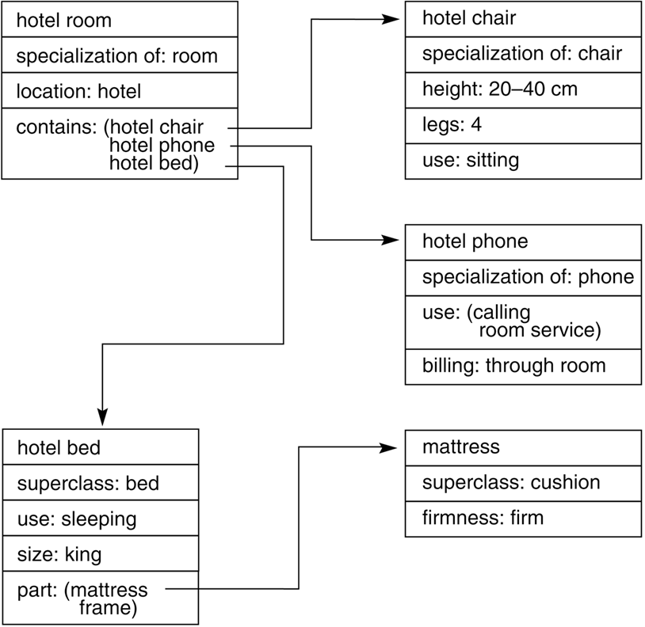
Continued…

Slide 57
Conceptual Dependency (CD)
CD theory was developed by Schank in 1973 to 1975 to represent the meaning of NL sentences.
It helps in drawing inferences
It is independent of the language
CD representation of a sentence is not built using words in the sentence rather built using conceptual primitives which give the intended meanings of words.
CD provides structures and specific set of primitives from which representation can be built.

Slide 58
Primitive Acts of CD theory
ATRANS Transfer of an abstract relationship (i.e. give)
PTRANS Transfer of the physical location of an object (e.g., go)
PROPEL Application of physical force to an object (e.g. push)
MOVE Movement of a body part by its owner (e.g. kick)
GRASP Grasping of an object by an action (e.g. throw)
INGEST Ingesting of an object by an animal (e.g. eat)
EXPEL Expulsion of something from the body of an animal (e.g. cry)
MTRANS Transfer of mental information (e.g. tell)
MBUILD Building new information out of old (e.g decide)
SPEAK Producing of sounds (e.g. say)
ATTEND Focusing of a sense organ toward a stimulus
(e.g. listen)

Slide 59
Some of Conceptualizations of CD
Dependency structures are themselves conceptualization and can serve as components of larger dependency structures.
The dependencies among conceptualization correspond to semantic relations among the underlying concepts.
We will list the most important ones allowed by CD.
Remaining can be seen from the book.

Slide 60
Conceptual category
There are four conceptual categories
ACT Actions {one of the CD primitives}
PP Objects {picture producers}
AA Modifiers of actions {action aiders}
PA Modifiers of PP’s {picture aiders}

Slide 61
Example
I gave a book to the man. CD representation is as follows:
P O R man (to)
I ⇔ ATRANS ← book
I (from)
It should be noted that this representation is same for different saying with same meaning. For example
I gave the man a book,
The man got book from me,
The book was given to man by me etc.

Slide 62
Few conventions
Arrows indicate directions of dependency
Double arrow indicates two way link between actor and action.
O – for the object case relation
R – for the recipient case relation
P – for past tense
D - destination

Slide 63
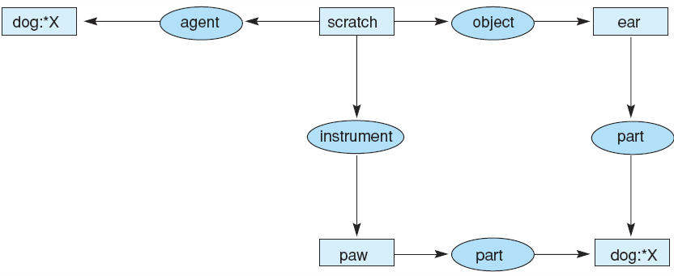
Conceptual graph of the sentence “The dog scratches its ear with its paw.”
Luger: Artificial Intelligence, 6th edition. © Pearson Education Limited, 2009

Slide 64
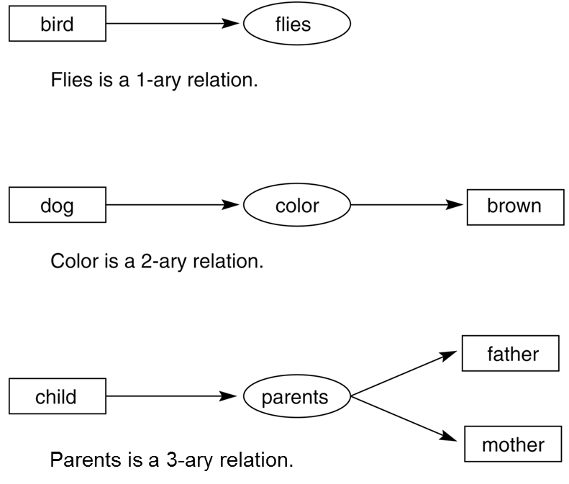
Conceptual Graph

Slide 65
Semantic nets
A semantic network is an irregular graph that has concepts in vertices and relations on arcs.
Relations can be ad-hoc, but they can also be quite general, for example, “is a” (ISA), “a kind of” (AKO), “an instance of”, “part of”.
Relations often express physical properties of objects (colour, length, and lots of others).
Most often, relations link two concepts.

Slide 66
Continued…
General semantic relations help represent the meaning of simple sentences in a systematic way.
A sentence is centered on a verb that expects certain arguments.
For example, verbs usually denotes actions (with agents) or states (with passive experiencers, for example, “he dreams” or “he is sick”).

Slide 67
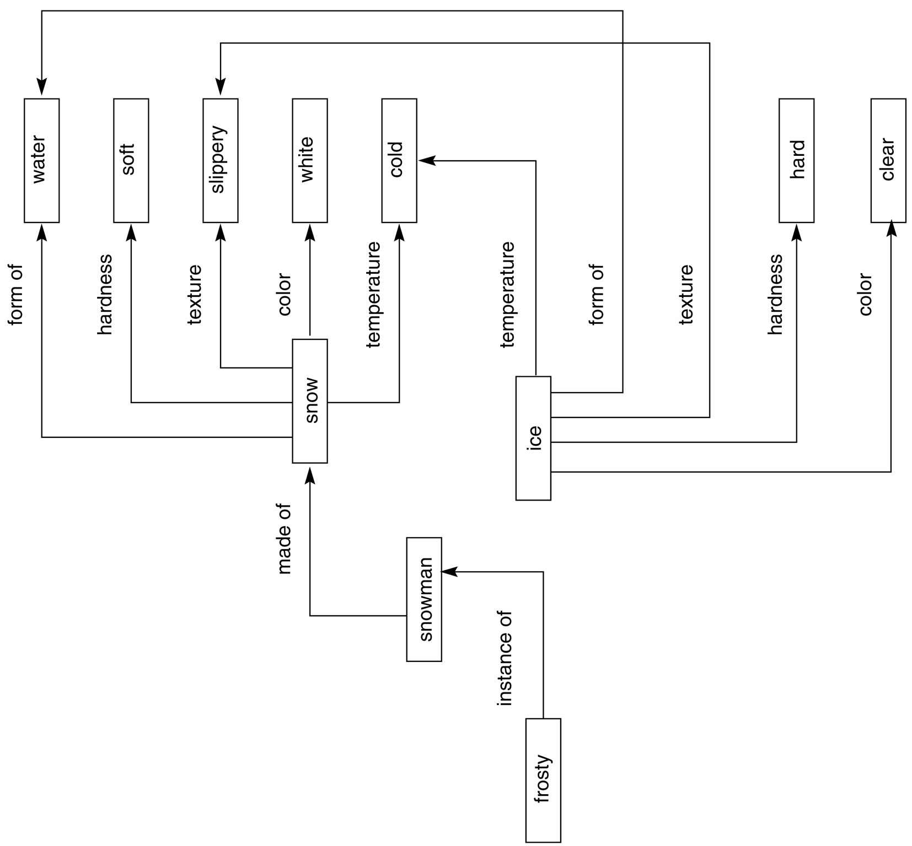
Continued…

Slide 68
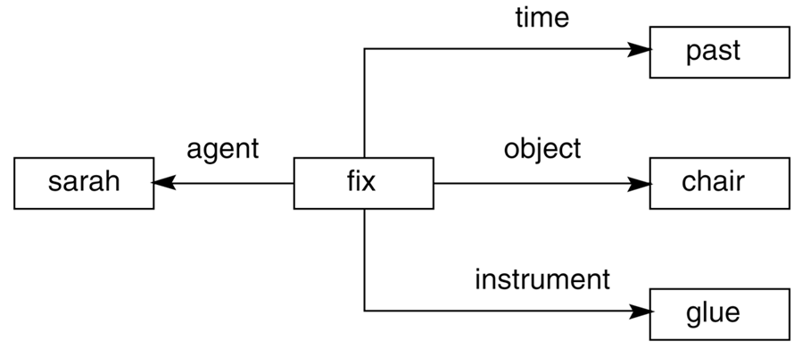
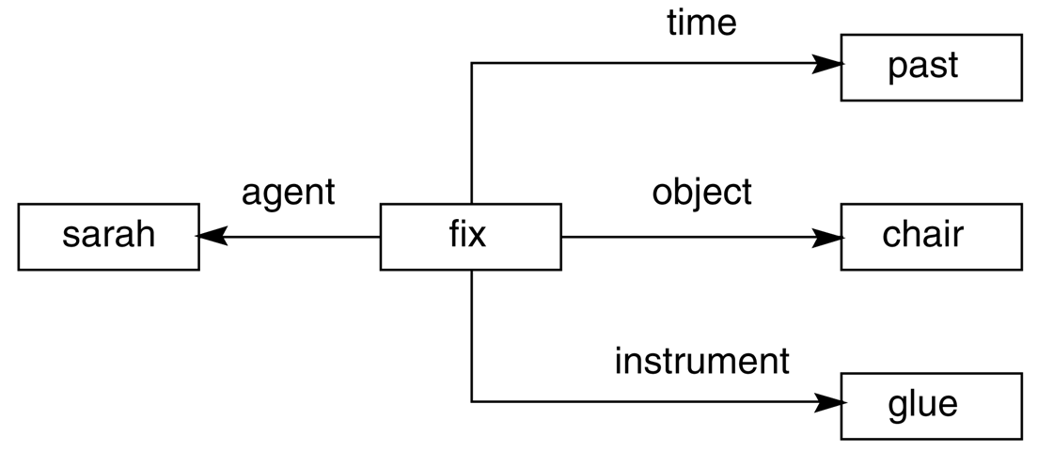
Continued…

Slide 69
What is planning in AI?
The planning in Artificial Intelligence is about the decision making tasks performed by the robots or computer programs to achieve a specific goal.
The execution of planning is about choosing a sequence of actions with a high likelihood to complete the specific task.

Slide 70
Motivation
•Many AI agents operate in an environment. Two issues:
•The agent wants to find a “good” sequence of actions that will take it from an initial to a goal state
•Every action of the agent changes some part of the state of the environment, keeping the remaining part unchanged.
•After every action, how to find which part changed, and which did not? Frame problem

Slide 71
A planning agent
An agent interacts with the world via perception and actions.
Perception involves sensing the world and assessing the situation
creating some internal representation of the world
Actions are what the agent does in the domain. Planning involves reasoning about actions that the agent intends to carry out
Planning is the reasoning side of acting
This reasoning involves the representation of the world that the agent has, as also the representation of its actions.
Hard constraints where the objectives have to be achieved completely for success
The objectives could also be soft constraints, or preferences, to be achieved as much as possible

Slide 72
Example
•A robot has to pick up an object fallen on the floor at point A and keep it at point B on the floor in a room.
•State: positions of objects in the room + own position
•Robot actions: move one step LEFT, RIGHT, FORWARD, BACK, pick up object from floor, put down the object in its arm on the floor.
•Robot needs to find a “safe” way from point A to B, by exploring the environment
•Robot has a map of the entire room; knows all the objects in the room, and their positions.

Slide 73
Example: Travel Planning
•“Please plan an economy class round trip air-travel from Pune to France lasting 9 days covering at least 3 different locations. I want to spend at least 2 days in each location. I am interested in nature, history and art.”

Slide 74
Planning Types
1. STRIPS
2. Forward and Backward State Space Planning
3. Goal Stack Planning
4. Plan Space Planning
5. A Unified Framework For Planning

Slide 75
Planning in Blocks World
There is a flat surface on which blocks can be placed.
There are many square blocks, all of the same size.
Each block has a unique ID (we use A, B, C, … as IDs)
Blocks can be placed on top of each other.
There is a robot arm that can perform several actions related to moving the blocks around
The arm can hold at most one block at a time.
Assumption:
Each block can have at most 1 other block on top of it.

Slide 76
Predicates
A given “situation” (“state”) can be described using a formula made up of the following predicates
1. ON(A, B):block A is on block B
2. ONTABLE(A):block A is on the table
3. CLEAR(A):there is nothing on top of block A
4. HOLDING(A):the robot arm is holding block A
5. ARMEMPTY:the robot arm is holding nothing

Slide 77
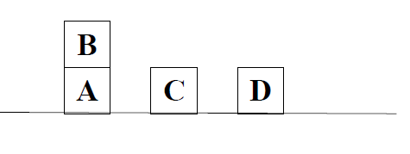
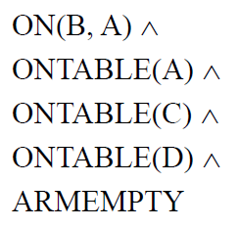
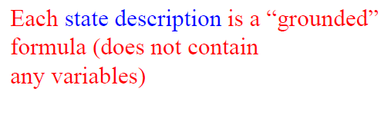
Example

Slide 78
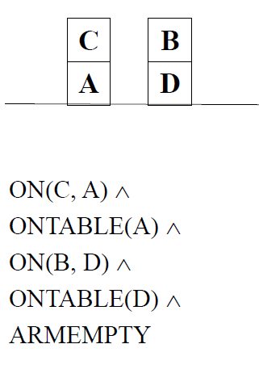
Another example

Slide 79
Actions the Robot Arm Can Perform
Each action (operator) transforms one state into another.
Each action has associated with it:
PRECONDITION: list of predicates that must be TRUE before the action can be applied
ADD: list of predicates that become TRUE after the actions applied
DELETE: list of predicates that become FALSE after the action is applied
Any predicate not included in either the ADD or the DELETE list is assumed to be unaffected by the action

Slide 80
Actions…
UNSTACK(x, y):pickup block x from its current position on block y.
–PRECONDITION: ARMEMPTY ∧ON(x, y) ∧ CLEAR(x)
–DELETE: ARMEMPTY ∧ ON(x, y)
–ADD: HOLDING(x) ∧ CLEAR(y)
–Note: CLEAR(x) is still true, even after the action occurs!
STACK(x, y):place block x on block y.
–PRECONDITION: CLEAR(y) ∧ HOLDING(x)
–DELETE: CLEAR(y) ∧ HOLDING(x)
–ADD: ARMEMPTY ∧ ON(x, y) ∧ CLEAR(x)

Slide 81
Actions…
PICKUP(x): pickup block x from the table and hold it.
–PRECONDITION: ARMEMPTY ∧ CLEAR(x) ∧ ONTABLE(x)
–DELETE: ARMEMPTY ∧ ONTABLE(x)
–ADD: HOLDING(x)
PUTDOWN(x):putdown block x on the table
–PRECONDITION: HOLDING(x)
–DELETE: HOLDING(x)
–ADD: ARMEMPTY ∧ ONTABLE(x)

Slide 82
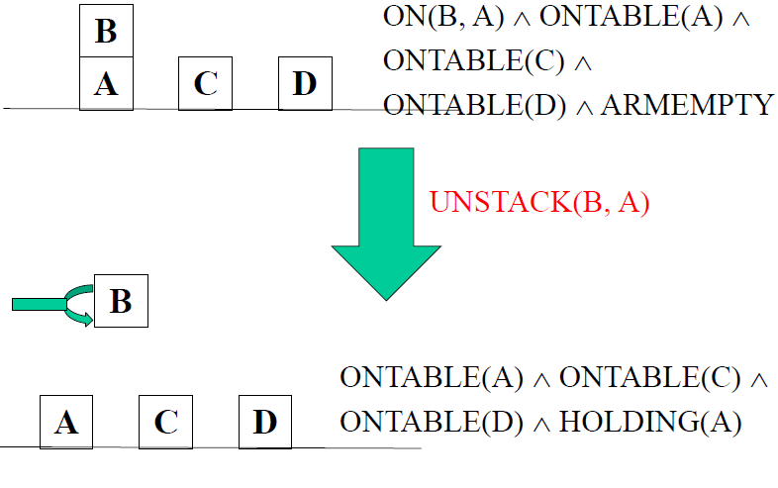
Continued…

Slide 83
The Planning Problem
Given an initial state S0, and a final (goal) state S1,
identify the “best” sequenceof actions that will transform S0 into S1.
Each action can only be one of: UNSTACK, STACK, PICKUP, PUTDOWN.

Slide 84
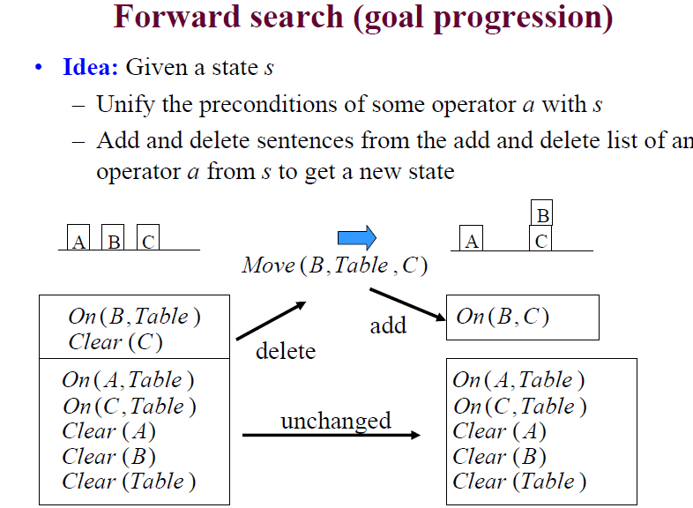

Slide 85
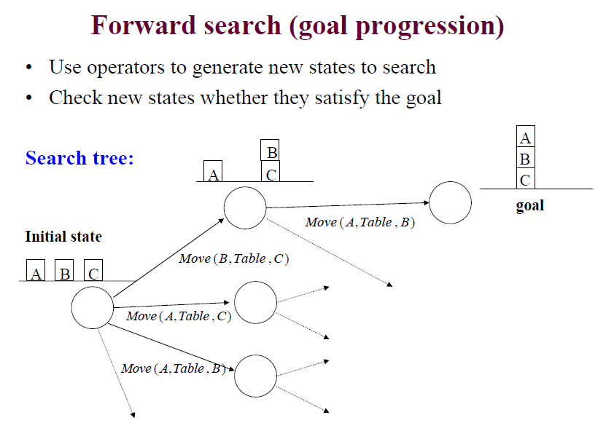

Slide 86
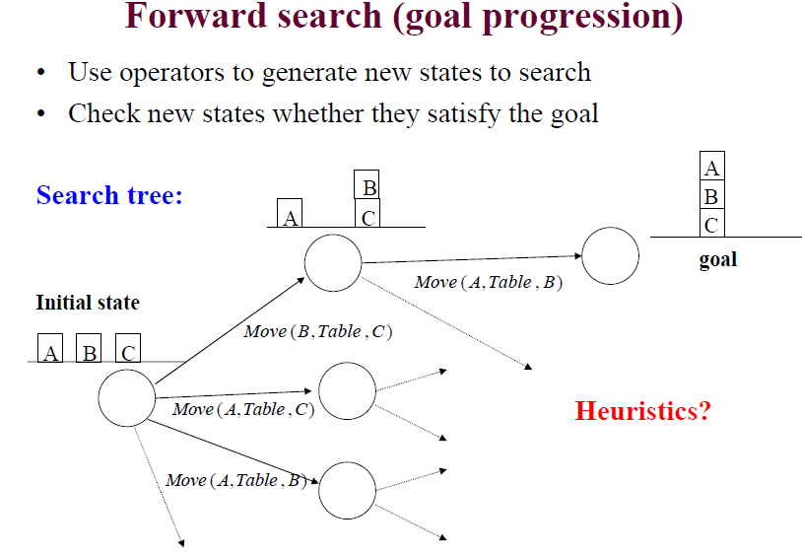

Slide 87
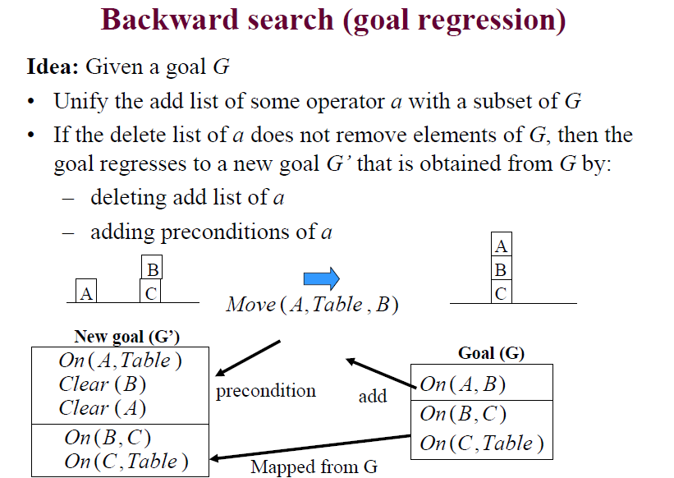

Slide 88
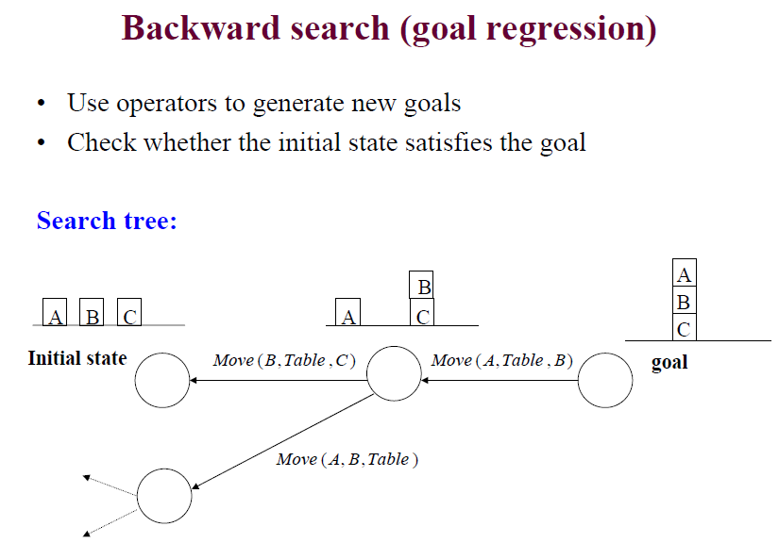

Slide 89
Forward planning
Start with the initial state (current world state).
Select actions whose preconditions match with the current state description (before-action state) through unification.
Apply actions to the current world state. Generate possible follow-states (after-action states) according to the add and delete lists of the action description.
Repeat for every generated new world state.
Stop when a state is generated which includes the goal formula.

Slide 90
Backward planning
Start with a given goal state description.
Check unsatisfied (pre)conditions of the goal description.
Select and apply actions which have those conditions as effects.
Proceed in the same way backwards, trying to fulfill preconditions of each new action by recursively choosing actions which achieve those preconditions.
Stop when the precondition is part of the initital state, and thus a sequence of actions is found leading from the initial state to the goal state.

Slide 91
Goal Stack Planning
Problem-solving is searching and moving through a state space.
Planning is searching for successful paths through a state space
Planning = problem solving in advance.
Planning is important if solutions cannot be undone.
If the universe is not predictable, then a plan can fail dynamic plan revision.

Slide 92
Goal Stack planning
Π:= φ // plan is initially empty
C:= start state // C is the current state
Push the goal state on the stack
Push all its subgoals on the stack (in any order)
Repeat until the stack is empty:
X:= Pop the top of the stack
IF X is a compound goal THEN
push its subgoals which are unsatisfied in C on the stack
ELSE IF X a single goal FALSE in C THEN
push an action Q that satisfies X
push all preconditions of Q
ELSE IF X is an action THEN
execute X in current state C, change the new current state C
using the action’s effects, add X to plan 
ELSE IF X is a goal which is TRUE in current state C THEN NOTHING

Slide 93
Goal Stack Planning algorithm
Push goal in the stack
if top is compound goal, push to stack
If top is single unsatisfied goal replace it by an action
Push action precondition
If top is action then pop
If top is satisfied goal then complete

Slide 94
Rules
R1 : pickup(x)
armempty, OnTable(x), clear(x)
R2: putdown(x)
holding(x)
R3:stack(x,y)
holding(x)
clear(y)
R4: unstack(x,y)
armempty, on(x,y), clear(x)

Slide 95
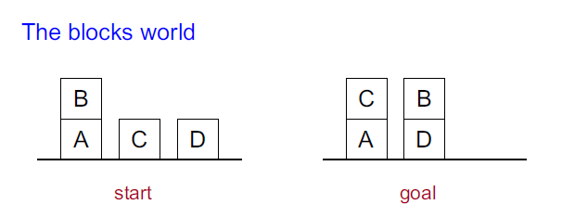
Continued...
Planning = generating a sequence of actions to
achieve the goal from the start

Slide 96
Continued...
Actions:
1. UNSTACK(A, B)
2. STACK(A, B)
3. PICKUP(A)
4. PUTDOWN(A)

Slide 97
Continued...
Conditions and results:
1. ON(A, B)
2. ONTABLE(A)
3. CLEAR(A)
4. HOLDING(A)
5. ARMEMPTY

Slide 98
Hierarchical planning
hierarchical decomposition : HIERARCHICAL an idea that pervades almost all DECOMPOSITION attempts to manage complexity.
For example, complex software is created from a hierarchy of subroutines or object classes; armies operate as a hierarchy of units; governments and corporations have hierarchies of departments, subsidiaries, and branch offices.
The key benefit of hierarchical structure is that, at each level of the hierarchy, a computational task, military mission, or administrative function is reduced to a small number of activities at the next lower
level, so the computational cost of finding the correct way to arrange those activities for the current problem is small

Slide 99
Hierarchical Planning
Principle
hierarchical organization of 'actions'
complex and less complex (or: abstract) actions
lowest level reflects directly executable actions
Procedure
planning starts with complex action on top
plan constructed through action decomposition
substitute complex action with plan of less complex actions (pre-defined plan schemata; or learning of plans/plan abstraction)
overall plan must generate effect of complex action

Slide 100
Continued...
Hierarchical Planning / Plan Decomposition
Plans are organized in a hierarchy. Links between nodes at different levels in the hierarchy denote a decomposition of a “complex action” into more primitive actions (operator expansion).
Example:
move (x, y, z)
operator
expansion pickup (x, y) putdown (x, z)
The lowest level corresponds to executable actions of the agent.

Slide 101
Hierarchical Plan - Example
Travel (source, dest.)
Take-Plane Take-Bus Take-Car
Goto (bus, source) Buy-Ticket (bus) Hop-on (bus) Leave (bus, dest.)
Goto (counter) Request (ticket) Pay (ticket)

Slide 102
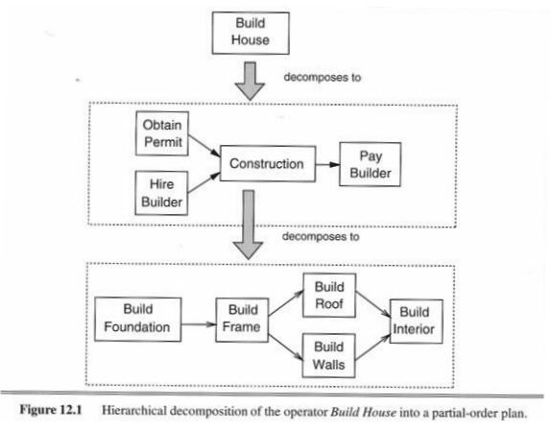
Hierarchical Plan - Example

Slide 103
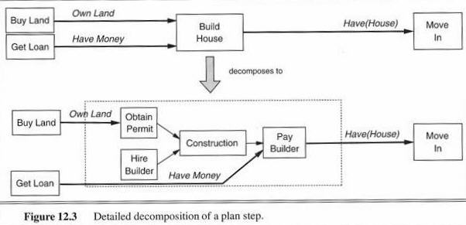
Hierarchical Plan - Example

Slide 104


